Slide 1
Seaborn: Statistical Data Visualization
OIM7502
Paula Toledano

Slide 2
What is Seaborn?
Seaborn is a Python data visualization library.
It builds on top of matplotlib and integrates closely with pandas data structures.
Provides a high-level interface for drawing attractive and informative statistical graphics.
Explore, understand, and present your data.
Key Features
Built-in themes and styling options for aesthetic visualizations.
Statistical plotting functions for visualizing relationships and distributions.
Fitting in and visualizing linear regression models.
Plotting statistical time series data.
Integration with Pandas data structures for seamless data handling.

Slide 3
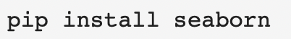
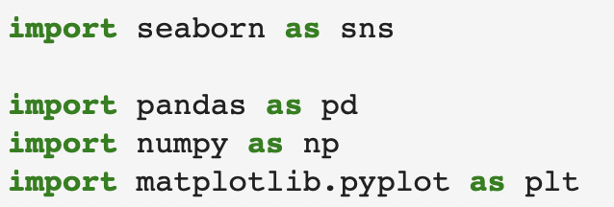
Installing and Importing Seaborn
Install with pip install command
Dependencies:
numpy
pandas
matplotlib

Slide 4
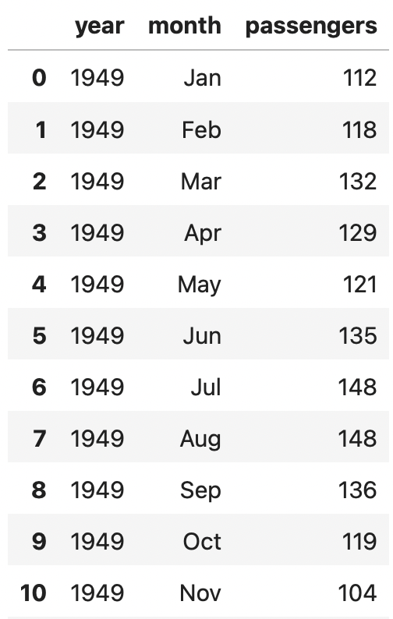
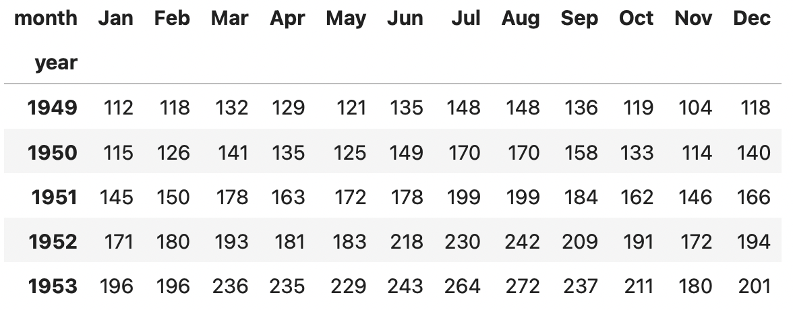
Data Structures
Wide-form data
Columns and rows contain levels of different variables
Long-form data
Each variable is a column
Each observation is a row

Slide 5
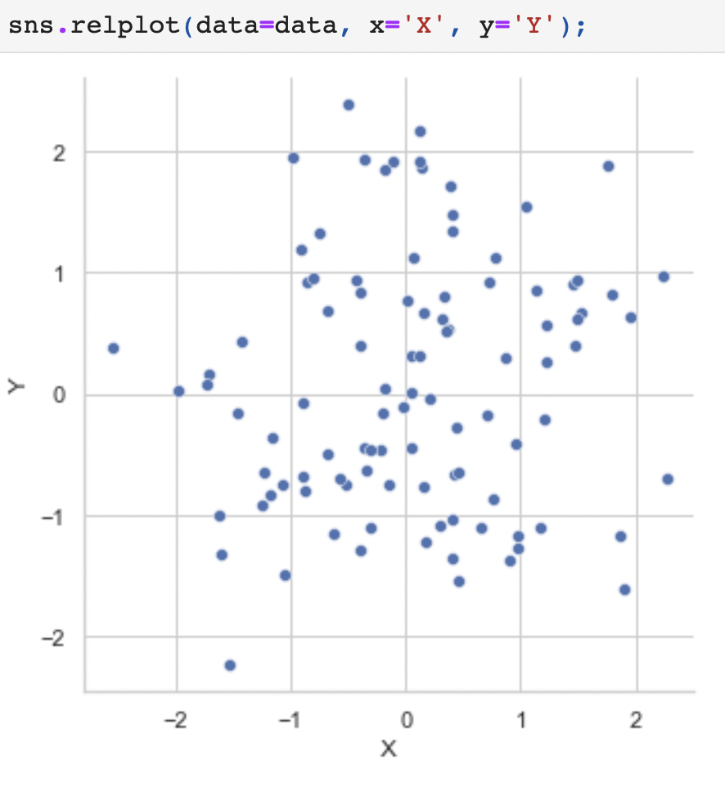
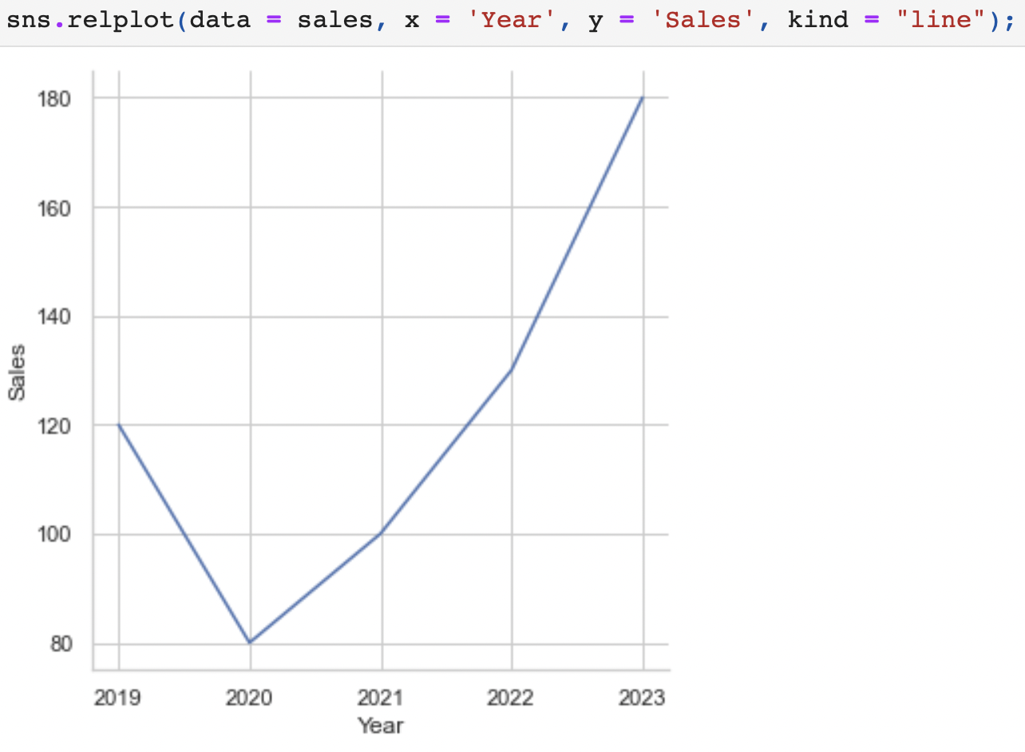
Statistical Relationship
Scatter plot
Line plot
Notes:
relplot( ) function (with kind="scatter"; the default)
relplot( ) function (with kind="line")

Slide 6
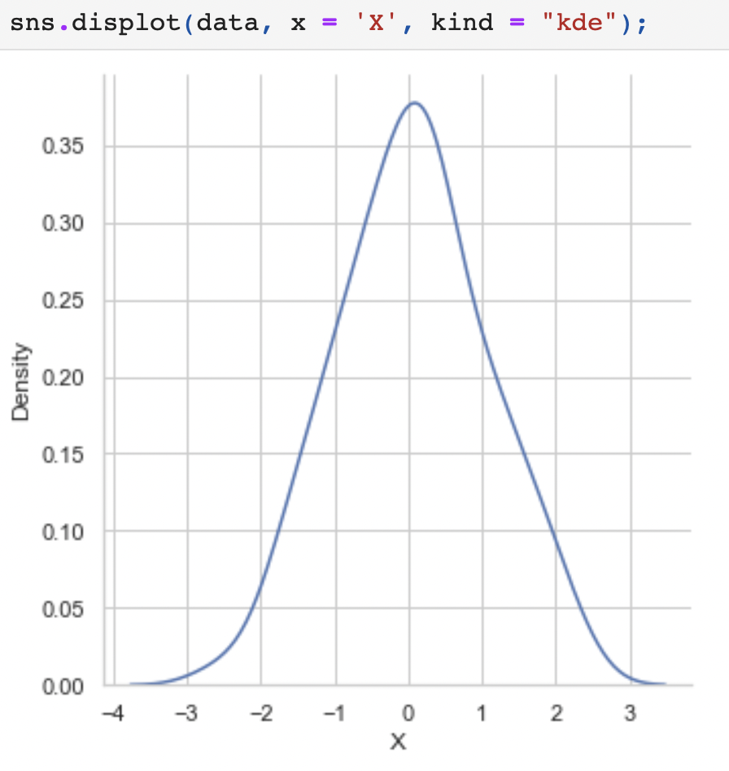
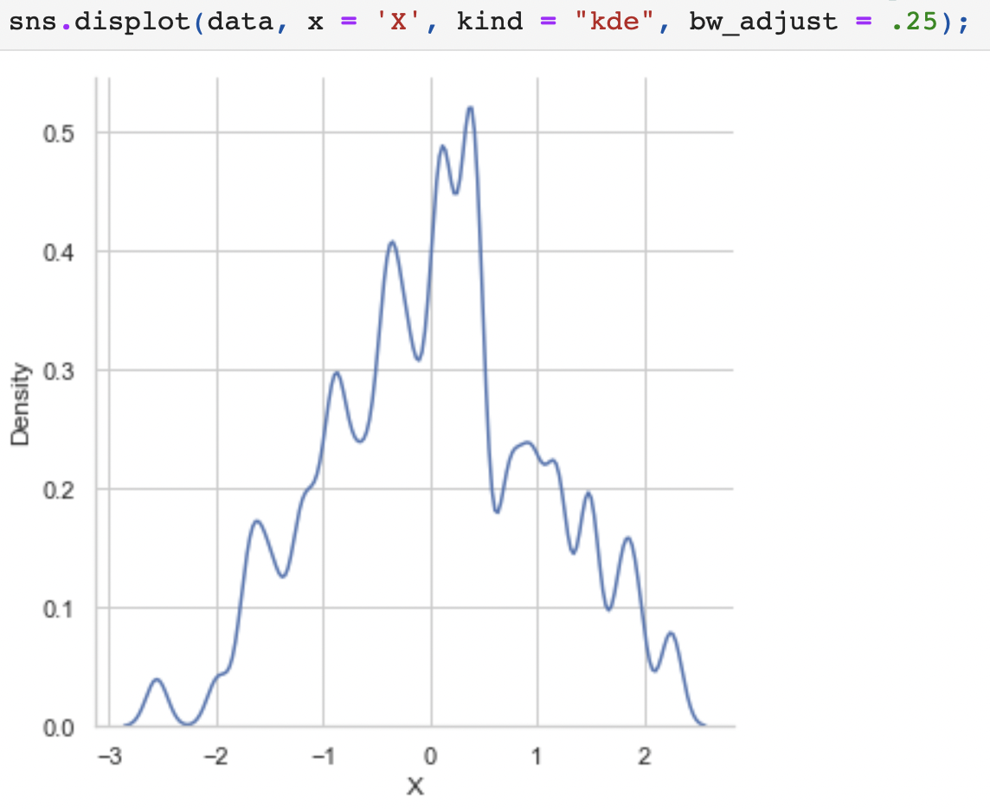
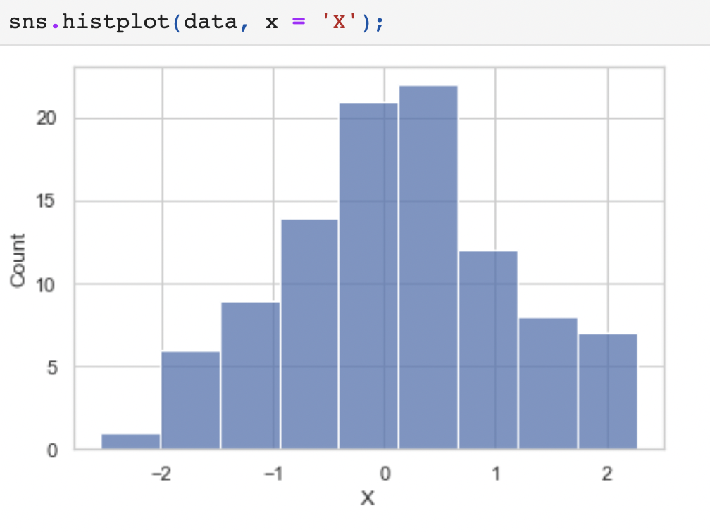
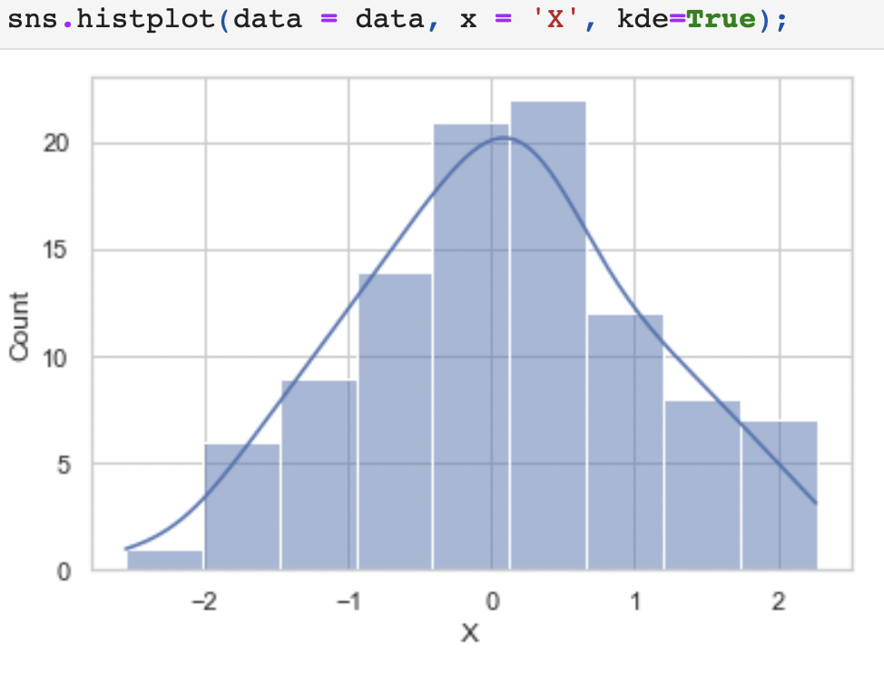
Distributions of Data
Kernel Density Estimation
Histogram
Notes:
Rather than using discrete bins, a KDE plot smooths the observations with a Gaussian kernel, producing a continuous density estimate.
Adjust the smoothing bandwidth
An over-smoothed estimate might erase meaningful features
An under-smoothed estimate can obscure the true shape within random noise

Slide 7
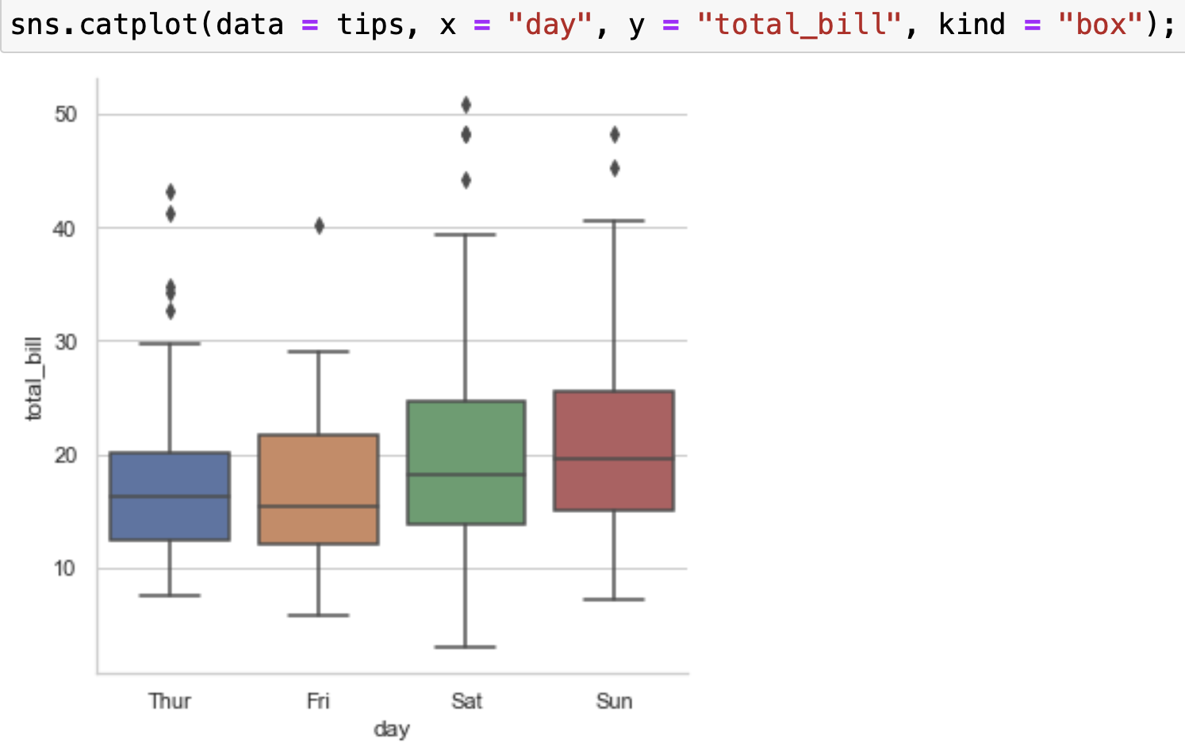
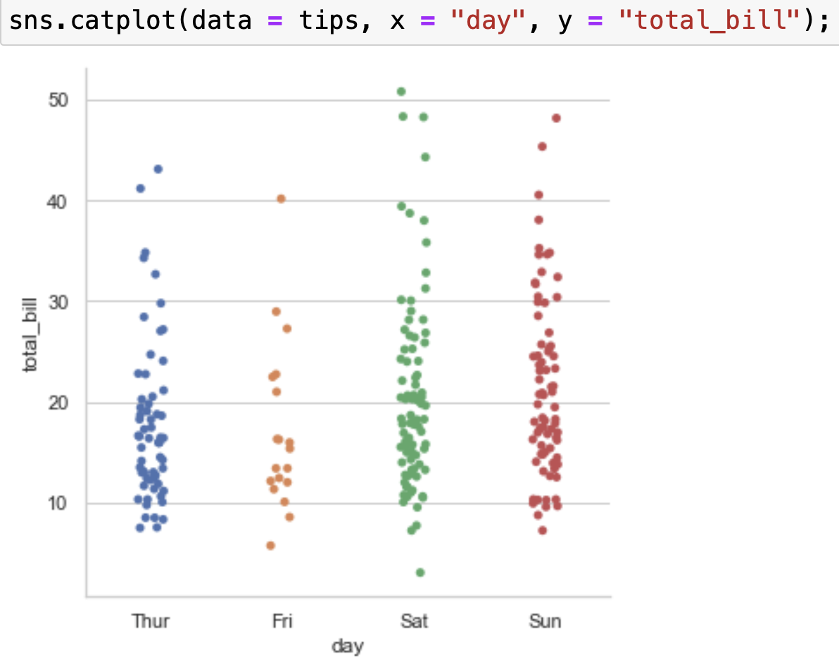
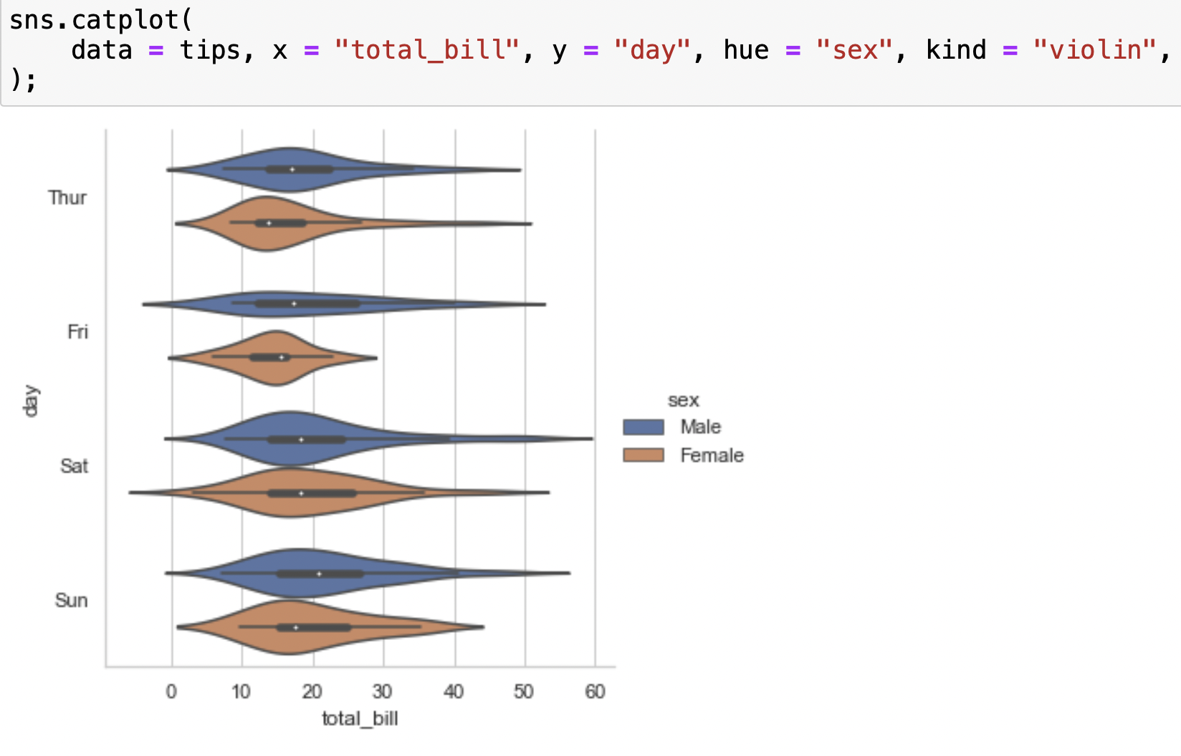
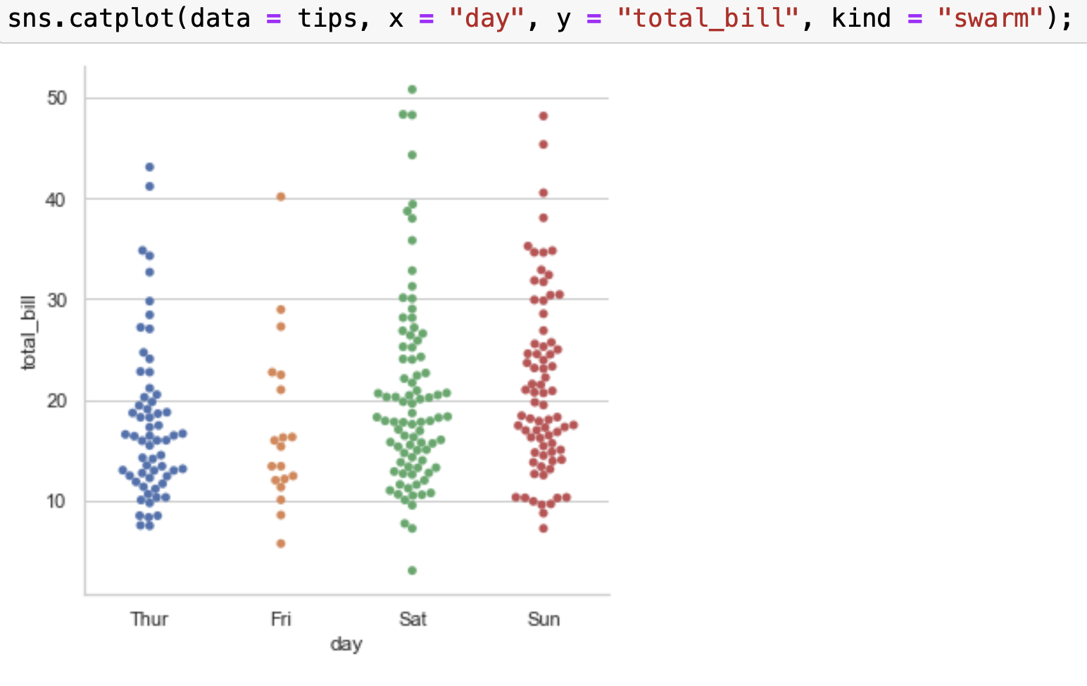
Visualizing Categorical Data
Notes:
There are a number of axes-level functions for plotting categorical data in different ways and a figure-level interface, catplot(), that gives unified higher-level access to them.
* Categorical scatterplots: all of the points belonging to one category would fall on the same position along the axis corresponding to the categorical variable.
* stripplot() (with kind="strip"; the default)
* swarmplot() (with kind="swarm")
* Adjusts the points along the categorical axis using an algorithm that prevents them from overlapping.
* Categorical distribution plots:
* boxplot() (with kind="box")
* violinplot() (with kind="violin")
* Combines a boxplot with the kernel density estimation procedure
* boxenplot() (with kind="boxen")
* Plot that is similar to a box plot but optimized for showing more information about the shape of the distribution.
* Categorical estimate plots:
* pointplot() (with kind="point")
* barplot() (with kind="bar")
* countplot() (with kind="count")

Slide 8
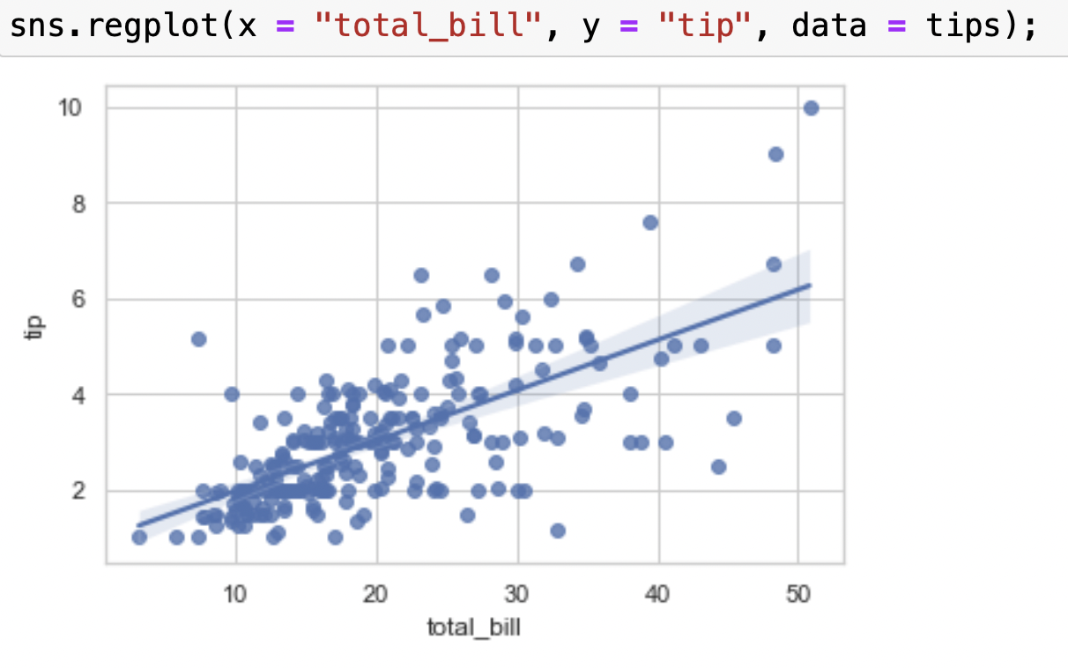
Estimating Regression Fit
Notes:
The two functions that can be used to visualize a linear fit are regplot() and lmplot(). lmplot() has data as a required parameter and the x and y variables must be specified as strings. Only lmplot() has hue as a parameter.

Slide 9
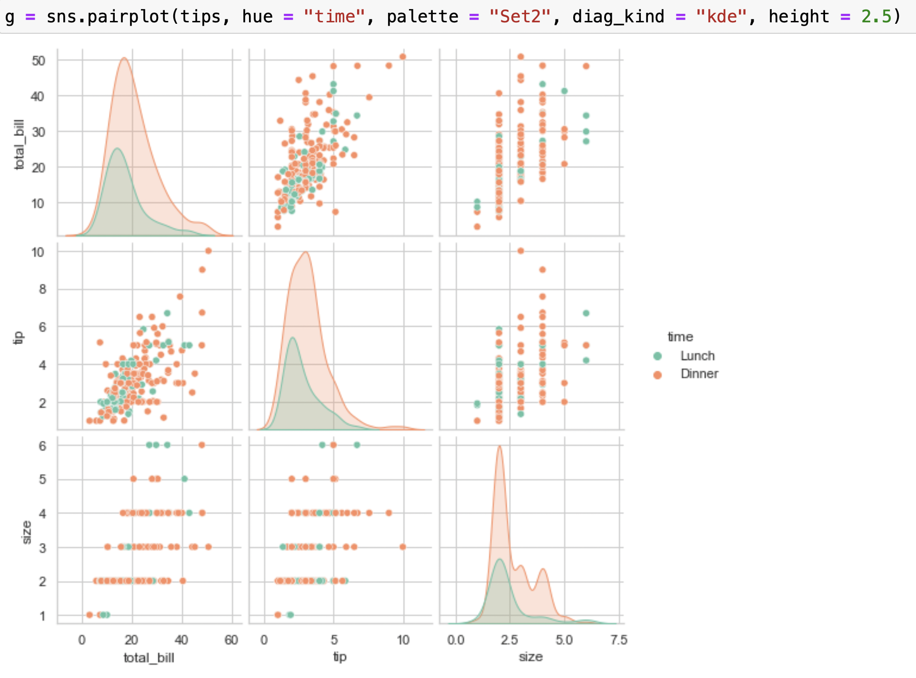
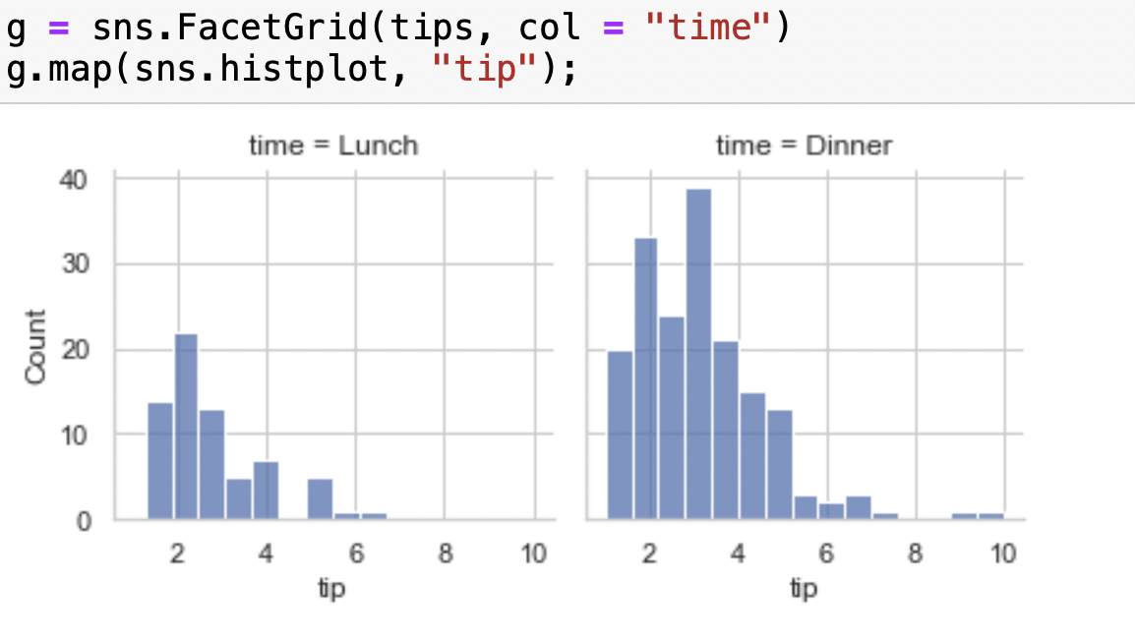
Structured Multiplot Grids
Notes:
The FacetGrid class is useful when you want to visualize the distribution of a variable or the relationship between multiple variables separately within subsets of your dataset. A FacetGrid can be drawn with up to three dimensions: row, col, and hue.

Slide 10
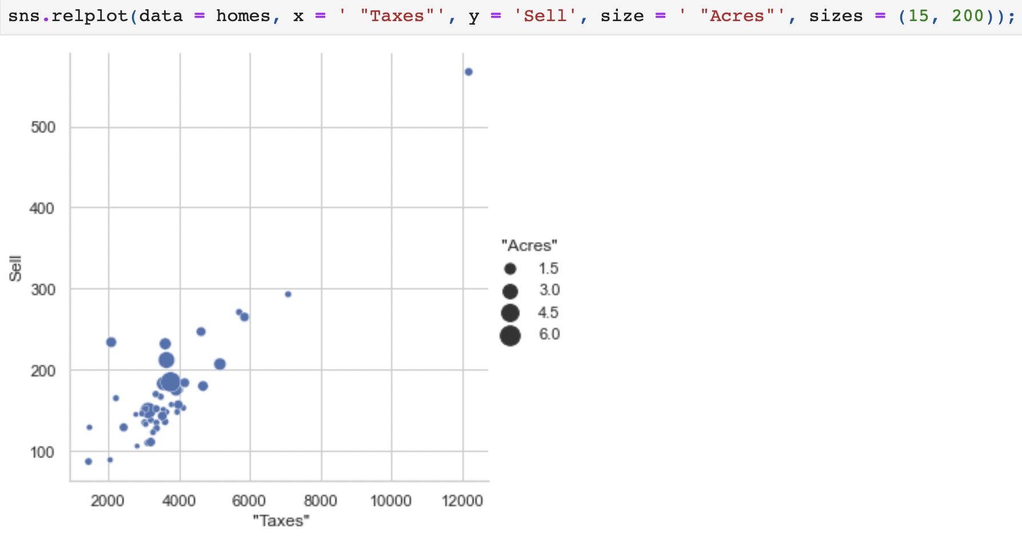
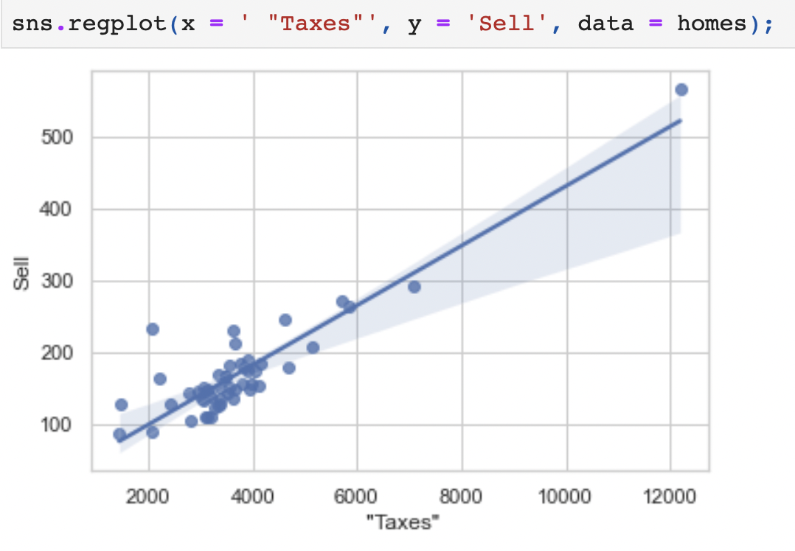
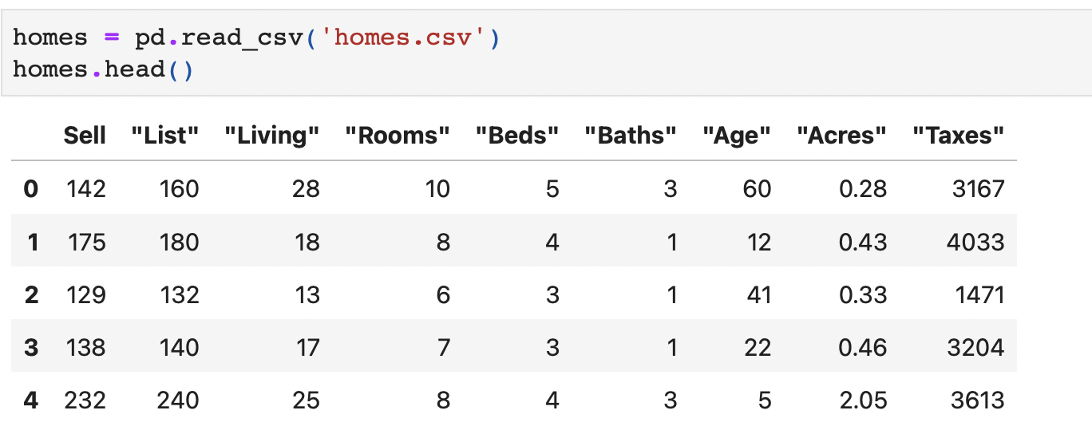
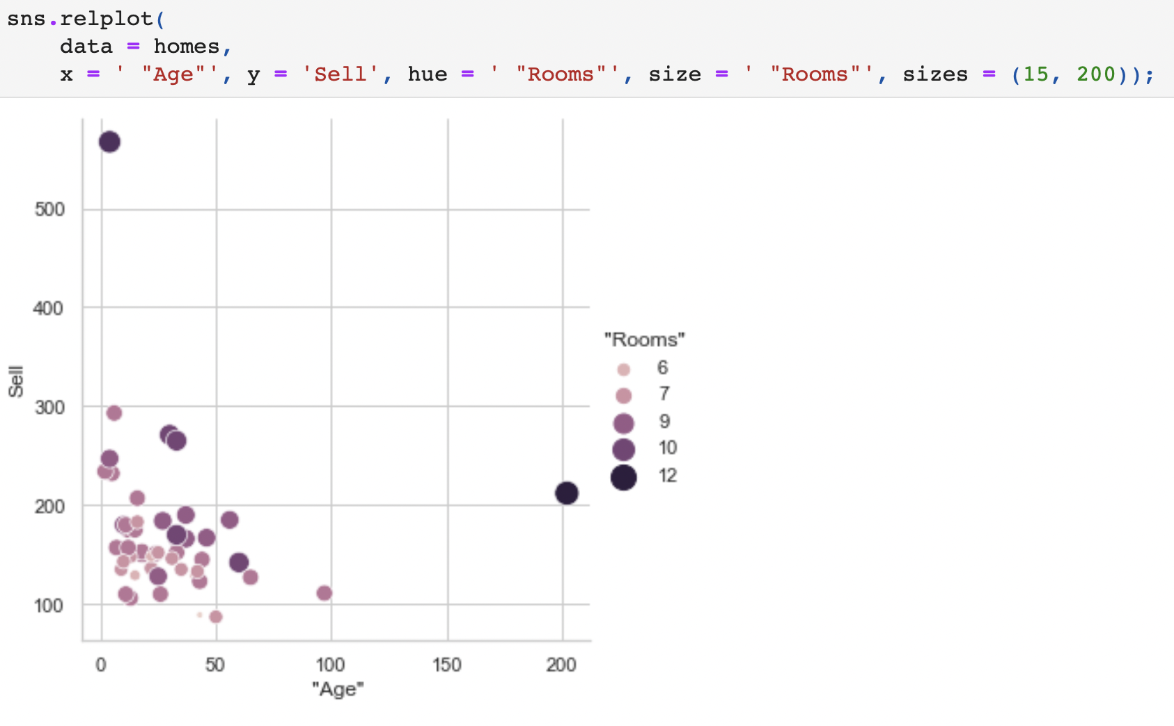
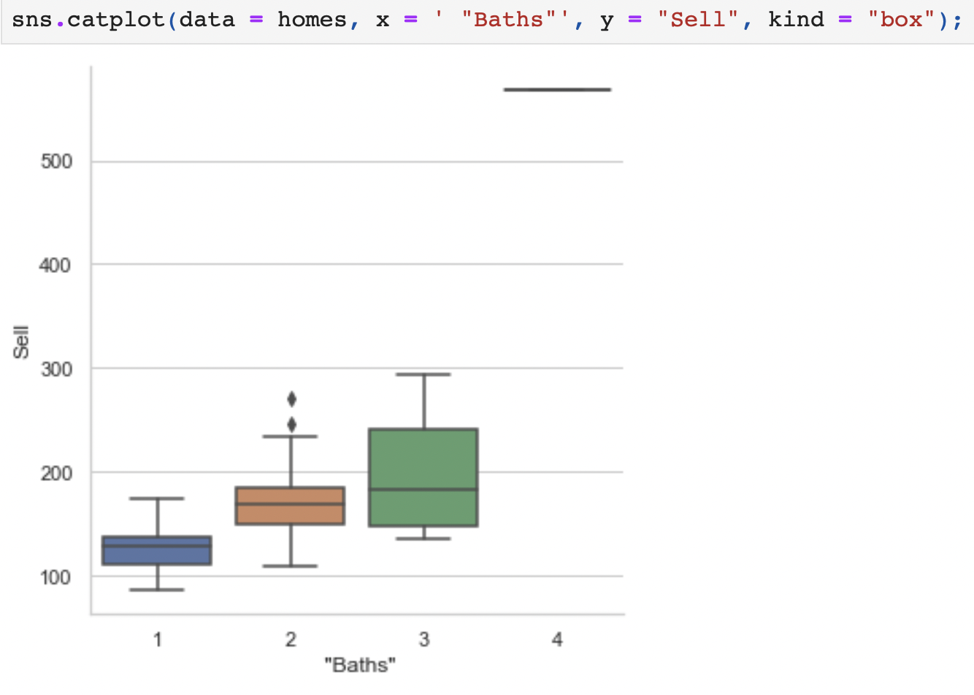
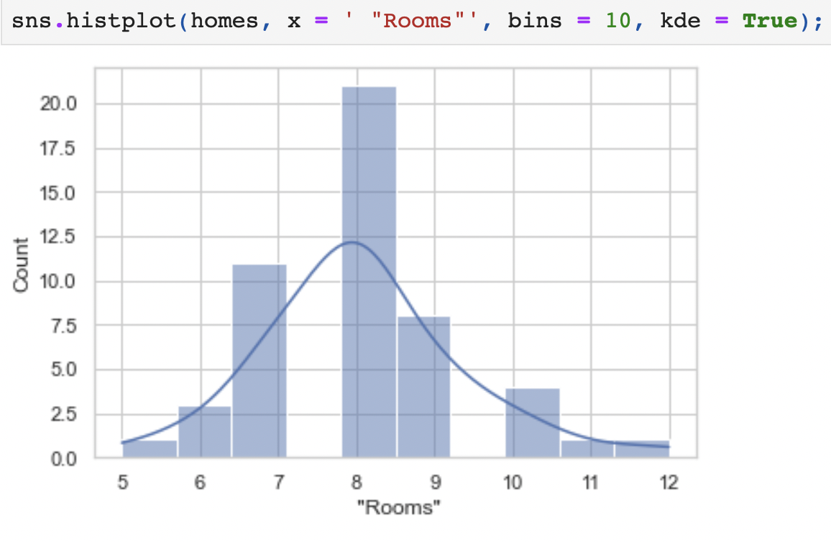
Example
Notes:
Seaborn has six variations of matplotlib’s palette, called deep, muted, pastel, bright, dark, and colorblind. These span a range of average luminance and saturation values.
There are five preset seaborn themes: darkgrid, whitegrid, dark, white, and ticks. They are each suited to different applications and personal preferences. The default theme is darkgrid.

